Slide 1
Multivariate Visualization
  Multivariate variate data visualization involves visualizing more than one data value in a single renderer. The programming language R, which is frequently used for data visualization, provides a number of tools for the visualization of multivariate data.
    Scatterplot
    Violin Plot
    Radar Chart
    Line Graph

Slide 2
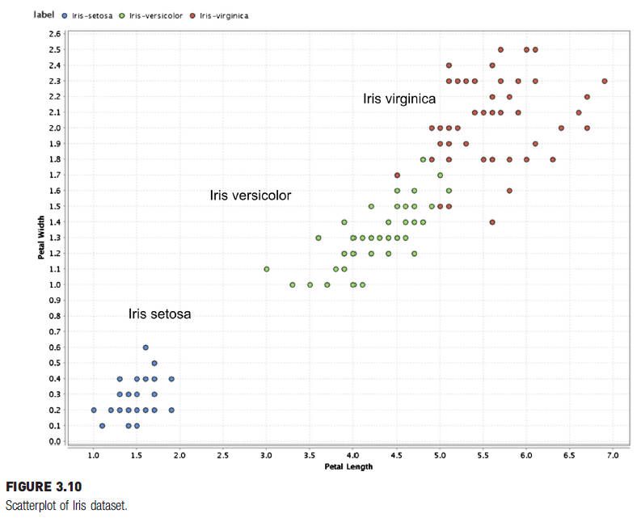
Scatterplot
Fig. 3.10 shows the scatterplot between petal length (x-axis) and petal width (y-axis).
These two attributes are slightly correlated, because this is a measurement of the same part of the flower.

Slide 3
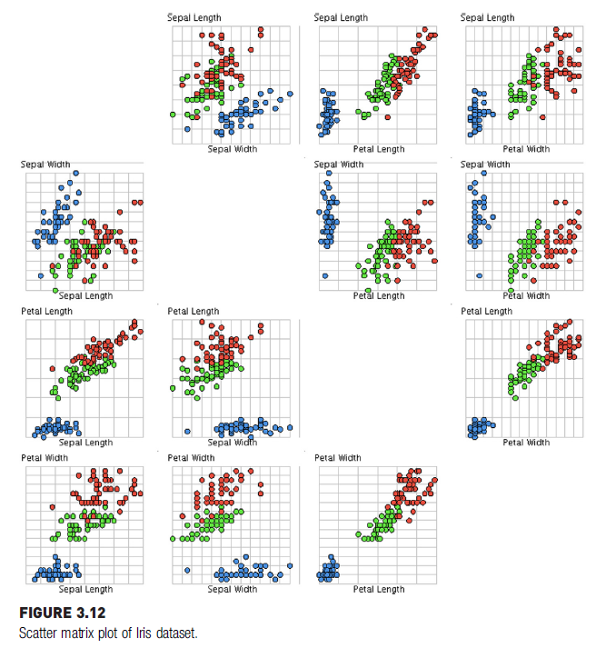

Scatter Matrix
A scatter matrix for all four attributes in the Iris dataset is shown in Fig. 3.12.
The color of the data point is used to indicate the species of the flower.
Since there are four attributes, there are four rows and four columns, for a total of 16 scatter charts. Charts in the diagonal are a comparison of the attribute with itself; hence, they are eliminated.

Slide 4
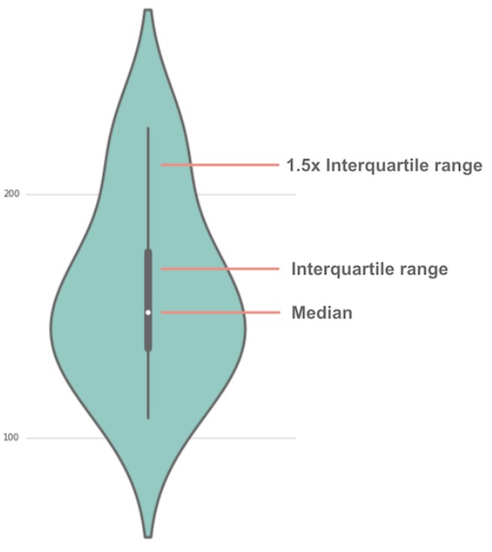


Violin Plot
Violin Plot is a method to visualize the distribution of numerical data of different variables.
A violin plot is a hybrid of a box plot and a kernel density plot, which shows peaks in the data.
Unlike a box plot that can only show summary statistics, violin plots depict summary statistics and the density of each variable.

Slide 5
How to read a violin plot
the white dot represents the median
the thick gray bar in the center represents the interquartile range.
the thin gray line represents the rest of the distribution.

Slide 6
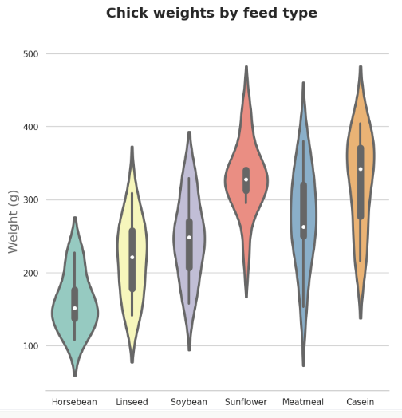
Example of a violin plot
About the data
The table modeanalytics.chick_weights contains records of 71 six-week-old baby chickens (aka chicks) and includes observations on their particular feed type, sex, and weight.The thick gray bar in the center represents the interquartile range.
This violin plot shows the relationship of feed type to chick weight.
The box plot elements show the median weight for horsebean-fed chicks is lower than for other feed types.

Slide 7
Example of a violin plot
The shape of the distribution (extremely skinny on each end and wide in the middle) indicates the weights of sunflower-fed chicks are highly concentrated around the median.

Slide 8
Radar Chart
A radar chart is an informative visual tool in which multiple variables (three or more) and compared on a two-dimensional plane. For this, we will create different axes emerging from a common central point. In most of the cases, all the axes are equally distributed and uniformly drawn from each other. Sometimes, the axes are also connected to each other to form different grids that make it easier for us to plot the spider chart.

Slide 9
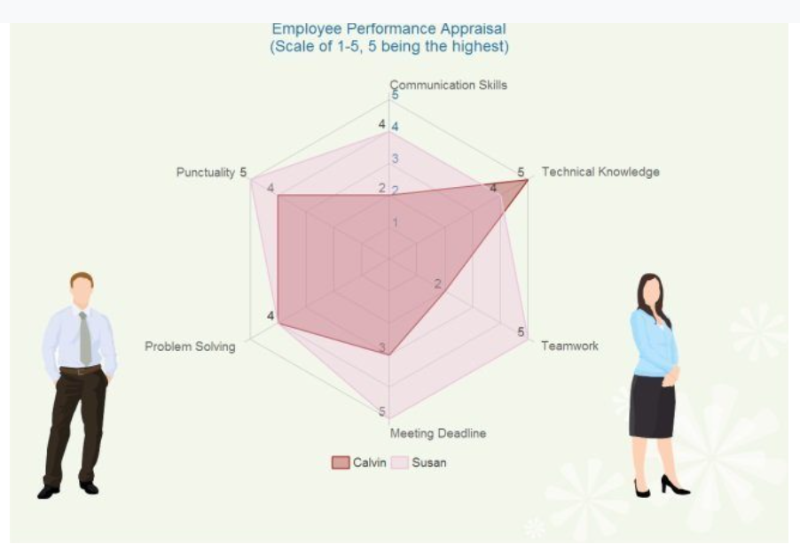
Example of a Radar Chart
Employee Performance Chart :
  In this example, you can see how the overall performance of two employees is compared using a spider graph.
  To compare them, we have used variables like punctuality, communication skills, technical knowledge, teamwork, etc. Furthermore, both the employees are allocated points (1-5) for each of these variables and are compared accordingly.

Slide 10
Line Graph
  Line graphs, also called line charts, are used to represent quantitative data collected over a specific subject and a specific time interval.
  All the data points are connected by a line.
  Line graph gives a graphical representation of the changes that had occurred over a given period of time.

Slide 11
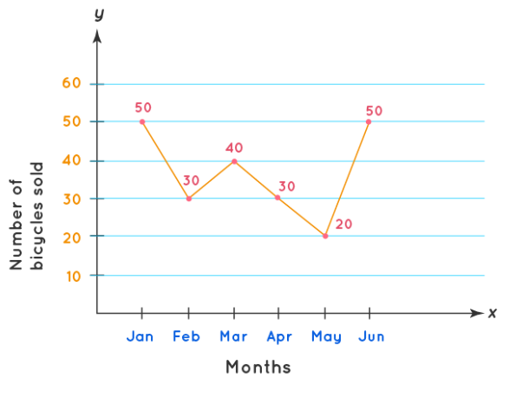
Example of a Line Graph
  The line graph shown above represents the sale of bicycles by a bicycle company from the month of January till JuneAll the data points are connected by a line.
  Here, the x-axis represents the time interval and the y-axis represents the number of bicycles sold each month.
  In the example shown, the number of bicycles sold in the month of January is 50. Similarly, in the month of February 30 bicycles were sold.

Slide 12
Example of a Line Graph
  We can interpret this data for each month using the data point.
  The line segment connecting these individual data points gives a picture of whether the sale of bicycles is in an increasing or decreasing trend.

